Slide 1

www.espirity.com
Eclipse Introduction
Dwight Deugo (dwight@espirity.com)
Nesa Matic (nesa@espirity.com)
Notes:
Portions of the notes for this lecture include excerpts from the Eclipse 3.0 Help facility. These excerpts are made available under CPL for ease of use by instructors, (c) Copyright (c) 2000, 2004 IBM Corporation and others. For more complete information instructors are encouraged to read the full notes from the Eclipse Help facility.

Slide 2
Additional Contributors
None as of September, 2004

Slide 3
Module Overview
Eclipse Overview
Installing and Running Eclipse
Workbench Overview
Notes:
Let’s begin with an overview of Eclipse.

Slide 4
Module Road Map
Eclipse Overview
  Background
  Architecture
  Components
  Usage scenarios
Installing and Running Eclipse
Workbench Overview
Notes:
Let’s begin with an overview of Eclipse.

Slide 5
What is Eclipse?
Eclipse is an open source project
  http://www.eclipse.org
  Consortium of companies, including IBM
  Launched in November 2001
  Designed to help developers with specific development tasks
Consists of four separate projects:
  Eclipse Project
  Eclipse Tools Project
  Eclipse Technology Project
  Eclipse Web Tools Platform Project
Notes:
The Eclipse Project was designed to provide a platform for building of highly integrated development tools. It was initiated by IBM with a consortium of companies, which now include companies such as Borland, Fujitsu, HP, Hitachi, Object Management Group, Oracle, Parasoft, QNX Software Systems, Red Hat, SAP, and Sybase, in 2001.
The Eclipse Tools Project is designed to support building of variety of tools for The Eclipse Project. It provides single point of access to all tool developers to avoid overlapping and duplication in developing Eclipse tools.
The Eclipse Technology Project is designed to provide mechanism for on-going evaluation of Eclipse to developers, researchers, academics and educators.

Slide 6
IBM’s IDE History
1994
VisualAge for Smalltalk
1996
VisualAge for Java
VisualAge Micro Edition
2001
Eclipse Project
Notes:
In 1994 IBM has released VisualAge for Smalltalk, an IDE written in Smalltalk, meant to be used for developing Smalltalk applications.
When Java became popular, IBM has released VisualAge for Java, a Java IDE that was written in Smalltalk as well. Soon, the IDE gained great popularity.
In 2001 IBM has started Java based open-source initiative called Eclipse.

Slide 7
The Eclipse Platform Motivation
Application development tools construction support
Independent tool vendors support
GUI and non-GUI application development support
Numerous content types support
  Java, HTML, C, XML, ...
Easy integration of tools
Use of Java language for writing the tools
Multiple operating systems support

Slide 8
Plug-in Architecture
Eclipse Platform
Tool
(plug-in)
Workbench
Help
Tool
(plug-in)
…
Workspace
Team
Tool
(plug-in)
Platform Runtime
Notes:
The picture on this slide represents the high-level architecture of the Eclipse Platform.
All plug-ins must be added to the platform before it’s started. When platform is started, the Platform Runtime figures out what plug-ins are available and creates plug-in in-memory registry.
Team and Help on the picture represent existing “hooks” in Eclipse for adding help and team support to the applications and environment.
The Platform has 2 main components: the Workbench and the Workspace. The Workbench represents set of tools available for the user in the Eclipse environment and Workspace represents set of user defined components (projects, packages, classes, and more).

Slide 9
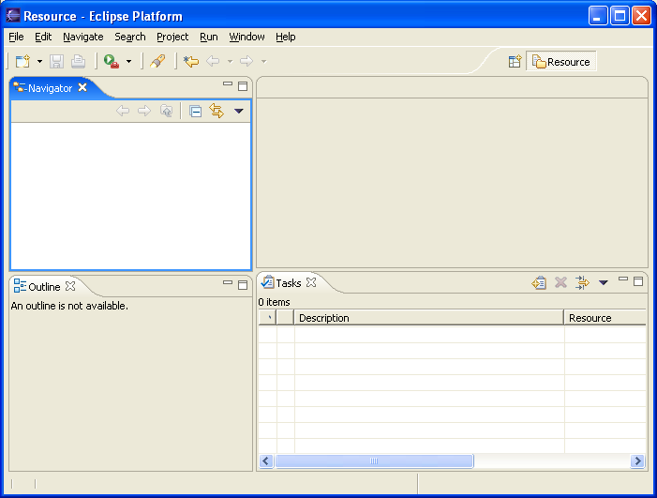
Workbench
Represents the desktop development environment
  It contains set of tools for resource management
  It provides common way of navigating through the resources
Multiple workbenches can be opened at the same time
Notes:
The term Workbench refers to the desktop development environment. The Workbench aims to achieve seamless tool integration and controlled openness by providing a common paradigm for the creation, management, and navigation of Workbench resources.
Each Workbench window contains one or more perspectives. Perspectives contain views and editors and control what appears in certain menus and tool bars. More than one Workbench window can exist on the desktop at any given time.

Slide 10
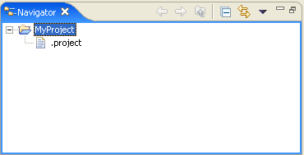
Workspace
Represents users data
It is a set of user defined resources
  Files
    Contain arbitrary number of bytes
  Folders
    Contain other folders or files
  Projects
    Collections of files and folders
Notes:
The central hub for your user's data files is called a workspace. You can think of the platform workbench as a tool that allows a user to navigate and manipulate the workspace. The resources plug-in provides APIs for creating, navigating, and manipulating resources in a workspace. The workbench uses these APIs to provide this functionality to the user. Your plug-in can also use these APIs.
From the standpoint of a resource-based plug-in, there is exactly one workspace, and it is always open for business as long as the plug-in is running. The workspace gets opened automatically when the resources plug-in is activated, and closed when the platform is shut down. If your plug-in requires the resources plug-in, then the resources plug-in will be started before your plug-in, and the workspace will be available to you.
The workspace contains a collection of resources. From the user's perspective, there are three different types of resources: projects, folders, and files. A project is a collection of any number of files and folders. It is a container for organizing other resources that relate to a specific area. Files and folders are just like files and directories in the file system. A folder contains other folders or files. A file contains an arbitrary sequence of bytes. Its content is not interpreted by the platform.
A workspace's resources are organized into a tree structure, with projects at the top, and folders and files underneath. A special resource, the workspace root resource, serves as the root of the resource tree. The workspace root is created internally when a workspace is created and exists as long as the workspace exists.
A workspace can have any number of projects.
Files and folders are similar to files and directories in the file system.
In the picture above we see MyServlet and MyWeb defined as projects and we see an images folder containing two files: .project and index.html

Slide 11
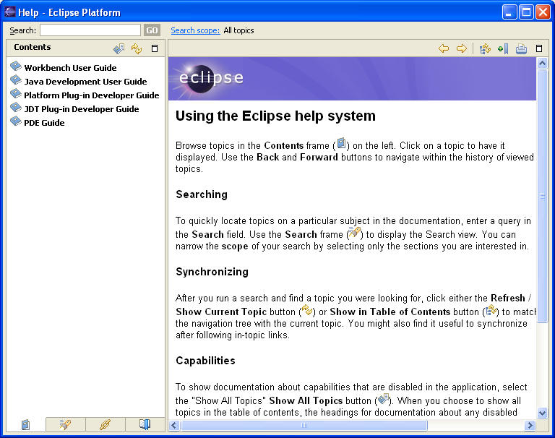
Help
Used for creating and publishing documentation
There are two different documentation styles:
  Help style documentation is published in the user guide
  API documentation is published in the programmer guide
Help content is in HTML format
Help navigation is in XML format
Notes:
The online help system provides access to the documentation, and lets you browse, search, and print it. The documentation is organized into sets of information that are roughly analogous to books. These, along with a full-text search engine and context-sensitive interface help, are designed to help you find the information you need.
The Eclipse platform's help facilities provide you with the raw building blocks to structure and contribute documentation to the platform. It does not dictate structure or granularity of documentation. You can choose the tools and structure for your documentation that suits your needs. The help plug-in allows you to describe your documentation structure to the platform using a table of contents (toc) file.
Your plug-in's online help is contributed using the org.eclipse.help.toc extension point. You can either contribute the online help as part of your code plug-in or provide it separately in its own documentation plug-in.

Slide 12
Team
Provides support for:
  Versioning
  Configuration management
  Integration with team repository
Allows team repository provider to hook into the environment
  Team repository providers specify how to intervene with resources
Has optimistic and pessimistic locking support
Notes:
The Eclipse Platform provides basic hooks for plugging team repository into the environment. There are different workflows for different team repository providers, and the platform lets providers to make decisions how resource management will be implemented.
In the pessimistic model, user checks out the resource and than the resource is locked for everybody else.
In the optimistic model, user can modify the resource while somebody else is modifying it as well. This usually results into manual intervention of modified resource – merging of two resource modifications.

Slide 13
How is Eclipse Used?
As an IDE - Integrated Development Environment
  Supports the manipulation of various content types
  Used for writing code
As a product base
  Supported through plug-in architecture and customizations

Slide 14
Eclipse as an IDE
Java Development Tooling (JDT) is used for building Java code
Provides set of workbench plug-ins for manipulating Java code
  Java projects, packages, classes, methods, ....
Java compiler is built in
  Used for compiling Java code
  Creates errors (special markers of code) if compilation fails
Notes:
Java Development Tooling provides set of plug-ins used for writing Java code. These plug-ins help in creating Java projects, packages, classes, methods, variables, and debugging code. Together they make a robust Java IDE.

Slide 15
Eclipse as a Product Base
Eclipse can be used as a Java product base
Its flexible architecture used as a product framework
  Reuse plug-in architecture
  Create new plug-ins
  Customize the environment
Notes:
When you use Eclipse as a product platform, you add your new features as plug-in to the standard directories of Eclipse: ..eclipse\plugins, and …eclipse\features. You then update the install.ini file to identify your primary features you use eclipse.exe to start the user interface. More details steps are identified in other modules.

Slide 16
Module Road Map
Eclipse Overview
Installing and Running Eclipse
  Where to get Eclipse?
  What is the support for Eclipse?
  Installing Eclipse
  Running Eclipse
Workbench Overview
Notes:
Let’s look at installing and running Eclipse.

Slide 17
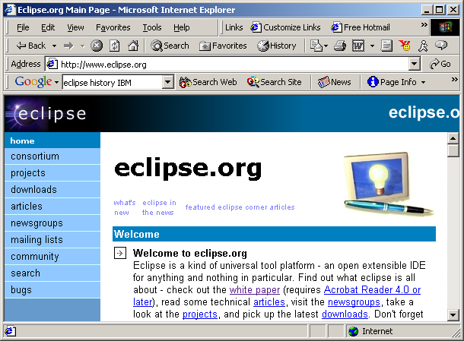
Getting Eclipse
Notes:
You can download eclipse by going to the Eclipse’s home page: http://www.eclipse.org

Slide 18
http://www.eclipse.org
Main point for finding Eclipse resources
  Downloads
  Articles
  Discussion groups
  Bugs
Contains various resources for using Eclipse
Contains references to other Eclipse related sites
Notes:
The Eclipse.org web page is your main source for finding and accessing Eclipse resource: downloads, articles, discussion groups, bug reports, and other references.

Slide 19
Downloading Eclipse’s Install Zip File
Click on the Download from the main page on http://www.eclipse.org
  Choose the closest site from which to download (geographical sites hosting the download)
  Choose the build for download (usually the latest build)
  Choose the platform for download and type of download (http or ftp)
  Specify where to save the download locally
Notes:
The download web page has many options for you to select from. These options include the closest download site, the build version, and the platform. Before the download begins, you will also be asked the name of the local directory to store the install zip file.

Slide 20
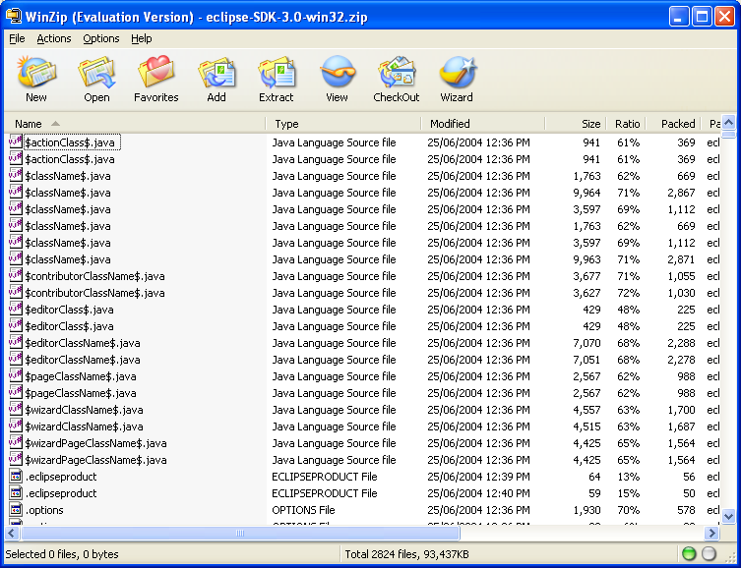
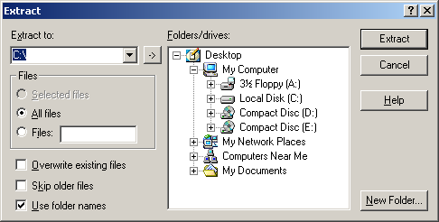
Installing the Eclipse
Unzip the downloaded file to the directory of your choice
Notes:
To install Eclipse, unzip the download file (eclipse-SDK-3.0-win32.zip) to a directory of your choice.

Slide 21
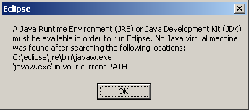
eclipse.exe
Eclipse is run by double-clicking on the eclipse.exe file
  The file is located in the Eclipse installation directory
If there is no path set for javaw.exe program, the following dialog will come up
Notes:
Eclipse is run by double-click on the eclipse.exe program that is located in the Eclipse installation directory, i.e. in the directory where downloaded zip file is unzipped.
If you don’t have Java Virtual Machine (JVM) set up in your path, a dialog will come up indicating that no JVM was found for running Eclipse. If you are missing a JVM, see the next slide.

Slide 22
Missing a Java VM? …
Download the latest Java Runtime Environment (JRE), e.g., v1.4.1_02 from http://java.sun.com/j2se/
Click on the downloaded EXE file to install
When given the option by the installer, identify a directory of your choice for the install files
Update the PATH environment variable to include the JRE’s bin directory
Notes:
One can download the latest Java Runtime Environment (JRE), e.g., v1.4.1_02, using the links found at http://java.sun.com/j2se/. Once the JRE’s “exe” file is downloaded, simply click on it to install. When given the option by the installer, identify a directory of your choice for the install files.
Once the installation has completed, you will need to update the PATH environment variable to include the JRE’s “bin” directory.

Slide 23
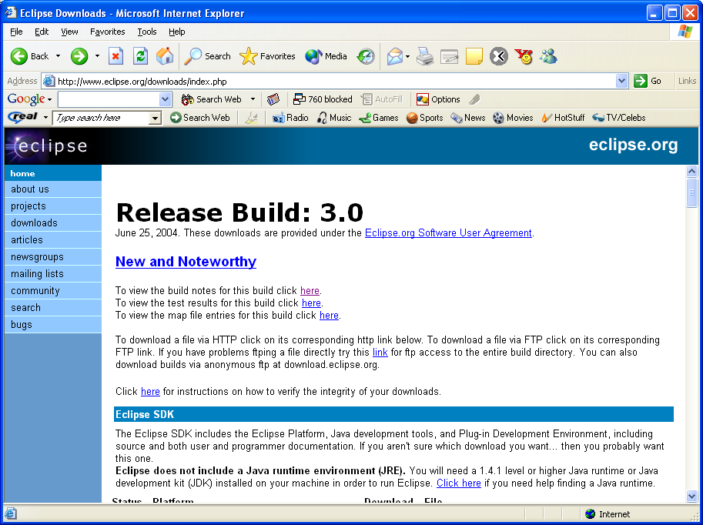
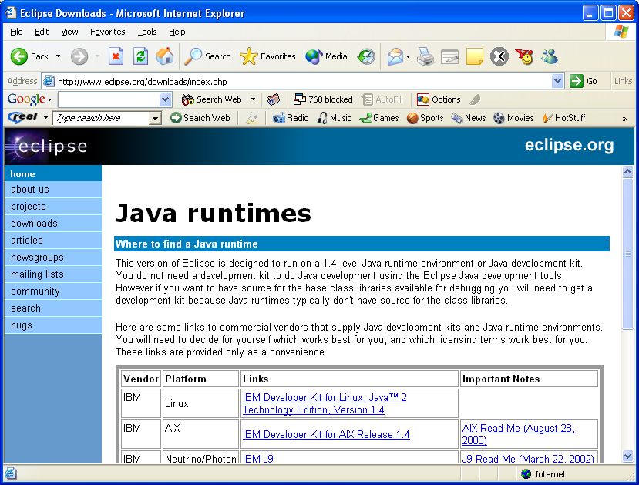
… Missing a Java VM?
Other VMs are available at the Eclipse download web site

Slide 24
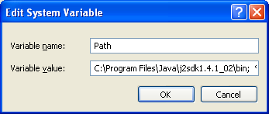
Specifying JVM
There are two ways of specifying JVM for Eclipse:
  By installing JVM under the \jre\ directory off the eclipse install directory
  By specifying existing JVM in the PATH environment variable
Start -> Control Panel -> System ->Advanced -> Environment Variables
Notes:
If JVM is already installed on the local system, simply set the PATH environment variable to indicate to the Eclipse where to find JVM.
If a JVM specific to Eclipse need to be used, it might be better idea to have it under \jre\ directory of the Eclipse installation directory.

Slide 25
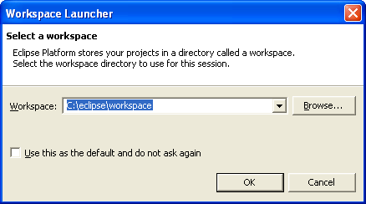
Specifying Workspace
The workspace contains user defined data – projects and resources such as folders and files
Eclipse prompts for a workspace location at the startup time
The prompt could be turned off
Notes:
By default, Eclipse uses a Workspace to store your projects, their resources and other information. Eclipse’s default works space is directory in your Eclipse installation directory called \workspace. You can change the default locations in the prompt or with arguments to the eclipse.exe.

Slide 26
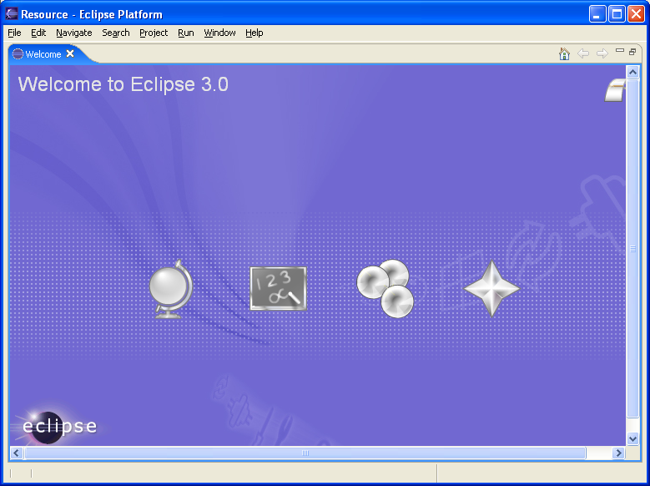
Running Eclipse
When Eclipse is run, a Welcome page opens
Notes:
Double click on the eclipse.exe found in the Eclipse install directory to run Eclipse and see the opening Workspace.

Slide 27
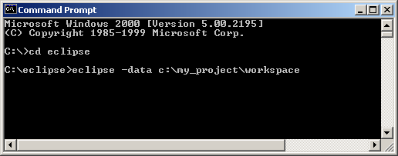
Running Different Workspace …
It is possible to run different workspaces using command prompt
  -data argument must be used with eclipse.exe
  Workspace location must be specified
Useful for grouping project specific data
Multiple workspaces can run at the same time
Notes:
For creating a new workspace, its location needs to be specified as an argument to eclipse.exe. The remainder of the work (meta data information) is done by the Eclipse.

Slide 28
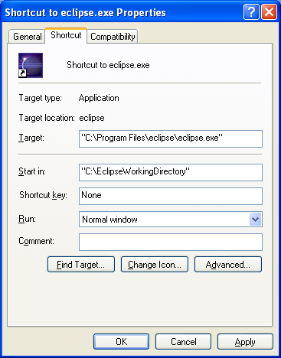
… Running Different Workspace
Customize your working directory by creating a shortcut identifying the eclipse.exe and the working directory
Notes:
To make starting Eclipse easy, create a shortcut (Windows only) specifying the location of the eclipse.exe and the default directory. Place the shortcut on the desktop for easy access.

Slide 29
Module Road Map
Eclipse Overview
Installing and Running Eclipse
Workbench Overview
  Basics
  Resources
  Components
    Perspectives, Views and Editors
  Specialized Views
    Bookmarks, Tasks, and Search
  Customization
Notes:
In this section, we look at an overview of the workbench. This includes Workbench basics, resources, components, manipulating resources, specialized views, and customization.

Slide 30
What is the Workbench?
Starting point for the development with Eclipse
  Opens up when Eclipse starts
  Represents the working environment in Eclipse
Notes:
When you start the Eclipse an instance of Workbench comes up. This is where you will be developing your Eclipse applications. Workbench contains perspectives, which contain editors and views. We will talk about Workbench components in few slides.

Slide 31
Multiple Workbench Instances
Instance of the workbench comes up when Eclipse launched
It is possible to open another instance of the Workbench
  Window → New Window
  This opens up a new Workbench window
  This is important when developing Eclipse plug-ins and you want to test them within the environment
    When testing plug-ins new instance of Workbench opens with developed plug-ins
Notes:
Multiple Workbench instances are important when working on plug-in development as they’re used for testing plug-ins within the environment. Also when you work on multiple projects it may be useful to have multiple Workbench windows open (one per project).

Slide 32
Resources in a Workbench
When working with Eclipse, you work with its resources
Resources are organized as a file/directory structure in the Workbench
  They correspond to the actual files and directories in the Workspace
  There are three different levels on resources:
    Projects
    Folders
    Files
Notes:
The Workspace is where your resources are stored. The default Eclipse workspace is under the \workspace\ directory off the Eclipse installation directory.

Slide 33
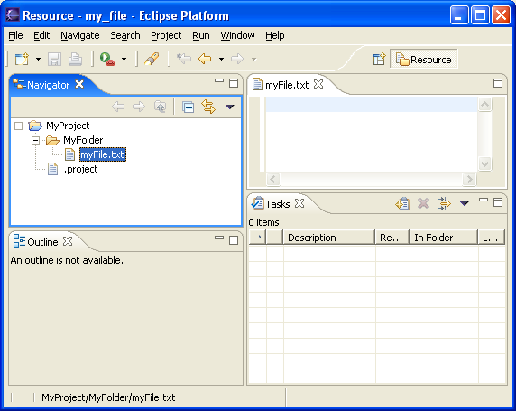
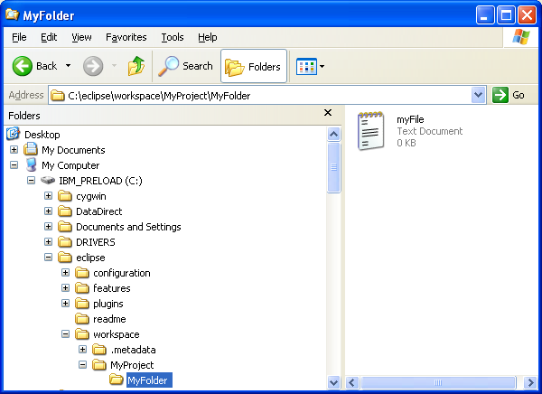
Organizing Resources
project
folder
file
Workbench
Workspace
It is possible to drag and drop resources directly between Workbench and the directory structure
Notes:
Projects are the top level of organizing resources in the Workbench. Projects contain folders and files. All of these resources correspond to the actual files in the Workspace for which is Workbench open.

Slide 34
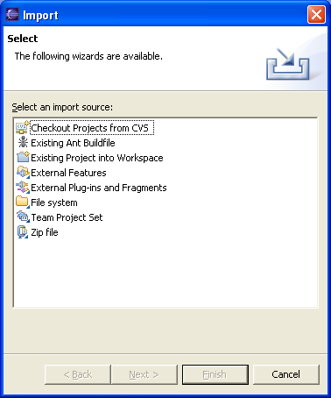
Importing Resources
Available through menu option File → Import…
Different source of resources can be imported:
  Existing projects
  Files (directory structure)
  Zip files
Notes:
Importing/Exporting feature of the Workbench is used a lot when moving work between different machines for example.

Slide 35
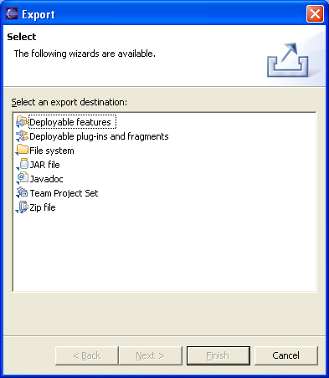
Exporting Resources
Available through menu option File → Export…
Different source of resources can be exported:
  File (directory structure)
  Zip files
  Jar files

Slide 36
Refreshing Workbench
Used for refreshing resources that change in the Workspace directly
For example, if file is added to the directory structure in the Workspace:
  Select the project
  Choose Refresh from the context menu
    This will bring the added resource into the Workbench
Notes:
In general, you should always be working with resources directly in the Workbench.

Slide 37
Resource History
Changes and saving a resource results in a new version of the resource
  All resource versions are stored in local history
  Each resource version is identified by a time stamp
  This allows you to compare different versions of the resource
There are two pop-up menu options available for accessing local history (the resource is selected):
  Compare With → Local History…
  Replace With → Local History…
  Both options bring up the same window
Notes:
Comparing local history and different versions of the resources may be important when frequently changing Java methods for example. This feature of Eclipse allows you to go back to previous versions of Java methods you change.

Slide 38
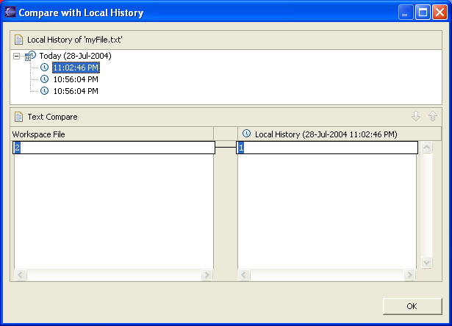
Comparing Files
Allows you to view differences between different versions
  You can move between differences
  Differences are selected

Slide 39
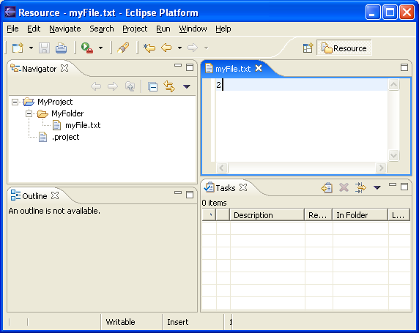
Workbench Components
Workbench contain perspectives
Perspective contain views and editors
perspective
editor
views
Notes:
Currently opened perspective is shown in the Workbench title bar. The default perspective that opens with Workbench is Resource perspective. We will talk about perspectives, views and editors in next few slides.

Slide 40
Perspectives
Perspective defines initial layout of the views in the Workbench
They are task oriented, i.e. they contain specific views for doing certain tasks:
  Java Perspective for manipulating Java code
  Resource Perspective for manipulating resources
  Debug Perspective for debugging applications
One Workbench window contains many perspectives
Notes:
Perspectives are what you will be, when developing applications, switching often between. Some perspectives open by default when an event occur. For example, if a breakpoint is encountered in the application, the Debugger perspective will open. In this perspective you can debug your code. We will talk more about debugging later in the module.

Slide 41
Opening Perspective
It is possible to open a perspective:
  In a same Workbench window
  In a new Workbench window
Perspective can be open by:
  Choosing Window → Open Perspective… menu option
  Clicking on a perspective shortcut button
Notes:
If you choose either option for opening perspective, a short list of perspectives available shows up. Full list of perspectives is shown than by choosing Other… from the proffered short list.

Slide 42
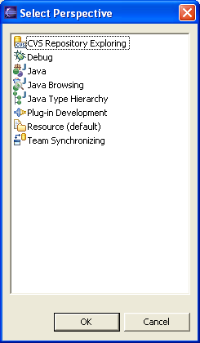
Available Perspectives
By default, the following perspectives are available in the Workbench:
Notes:
Resource perspective is used for manipulating resources.
Java, Java Browsing, and Java Browsing Hierarchy perspectives are used for manipulating Java code.
Debug perspective is used for debugging.
Plug-in development perspective is used for developing Eclipse plug-ins.
CVS Repository Explorer perspective is used for accessing CVS.

Slide 43
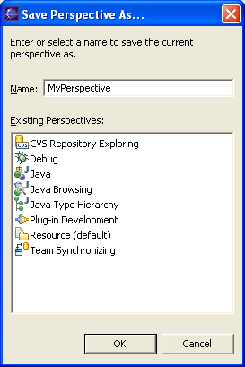
Saving Perspective
Arrangement of views and editors can be modified and saved for perspectives
  Choose Window → Save Perspective As… to save perspective
  Perspective can be saved under a new (use-defined perspectives) or an existing name
You can also reset perspective to original arrangement
  Choose Window → Reset Perspective
Notes:
Only perspectives that are default for Eclipse can be reset to original layout. Perspectives that are new cannot be reset.

Slide 44
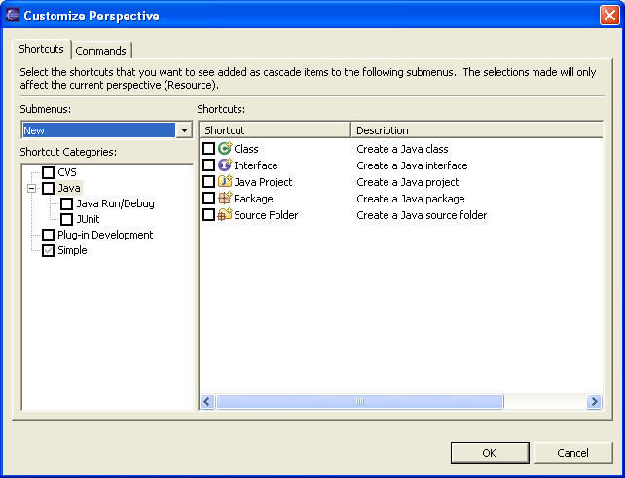
Customizing Perspectives
Available for current perspective
  Allows customization such as shortcuts, menu items and views

Slide 45
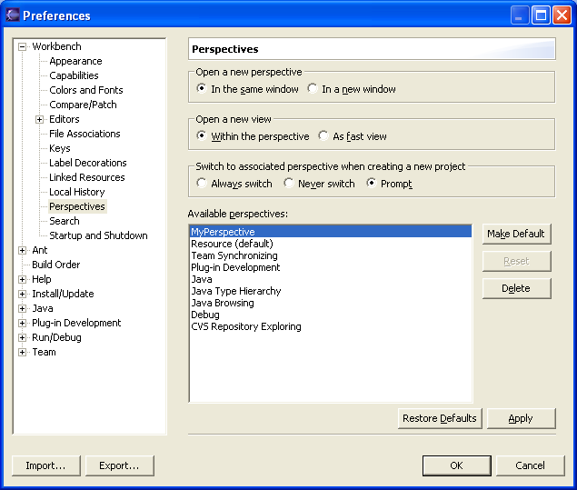
Deleting Perspectives
Only user-defined perspectives can be deleted
To delete perspective:
  Choose Window → Preferences
  Expend Workbench category
  Select Perspectives
  Select perspective for deleting
  Click Delete
Notes:
You cannot delete predefined perspectives that come with the Eclipse.

Slide 46
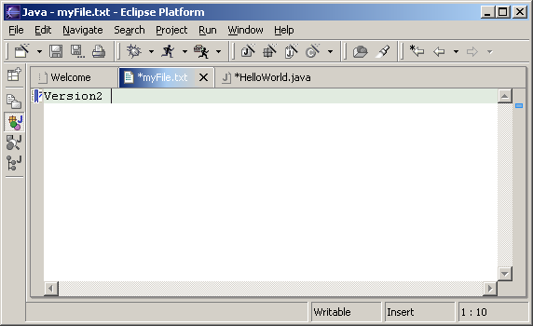
Editors
An editor for a resource opens when you double-click on a resource
  Editor type depends on a type of the resource, for example .txt files are open with the text editor
  When an editor opens on a resource, it stays open across different perspectives
    When perspectives change editor stays open
  Active editor contains menus and toolbars specific to that editor
  When you change a resource, an asterisk on the editor’s title bar indicates unsaved changes
Notes:
There is number of editors associated with particular file types in Eclipse. These are default editors, and they open automatically when you double-click on a resource in the Navigator view. You can also open an editor on a resource by choosing Open With option from the context menu on a resource in the Navigator view. This lets you choose another available editor for the selected resource type.

Slide 47
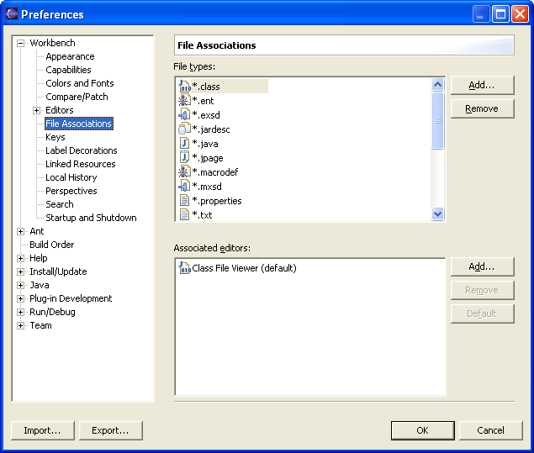
Editors and File Types
It is possible to associate an editor with a file type
  Choose Window → Preferences
  Select File Associations
  Select file type
  Click Add to associate it with an editor
Notes:
Once you associate file type with an editor that editor will appear in the list of available editors when you choose Open With from the context menu in the Navigator view.

Slide 48
Views…
The main purpose of a view is:
  To support editors
  To provide alternative presentation and navigation in the Workbench
Views can have their own menus and toolbars
  Items available in menus and toolbars are available only in that view

Slide 49
…Views
Views can:
  Appear on their own
  Appear stacked with other views
Layout of the views can be changed by clicking on the title bar and moving views
  Single views can be moved together with other views
  Stacked views can be moved to be single views

Slide 50
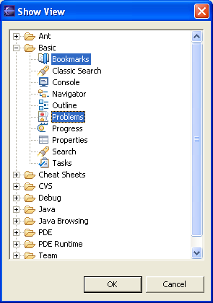
Adding Views to Perspective
To add a view to the current perspective:
  Choose Window → Show View → Other…
  The Show View window comes up
  Select window to be shown
  Click OK
Notes:
In the above example selecting Bookmark, and Tasks views will show views in the perspective.

Slide 51
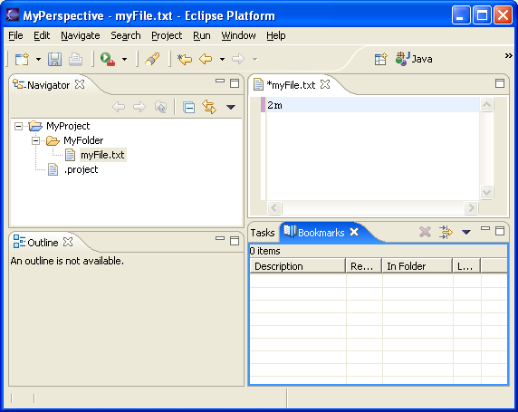
Stacked Views
Stacked views appear in a notebook form
  Each view is a notebook page

Slide 52
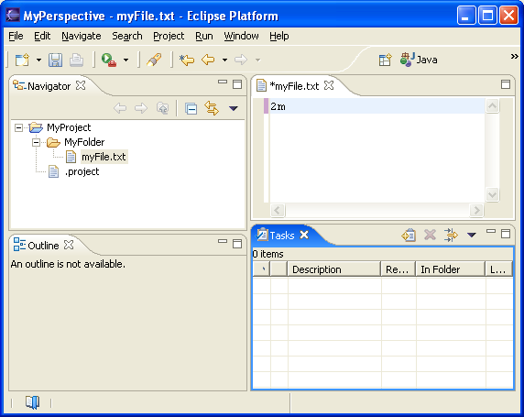
Fast Views…
Hidden views that can be quickly opened and closed
  They take up space in the Workbench
Fast views can be created by:
  Dragging an open view to the shortcut bar
  Selecting Fast View from the view’s menu
Fast View is activated by clicking on its Fast View pop-up menu option
Fast View

Slide 53
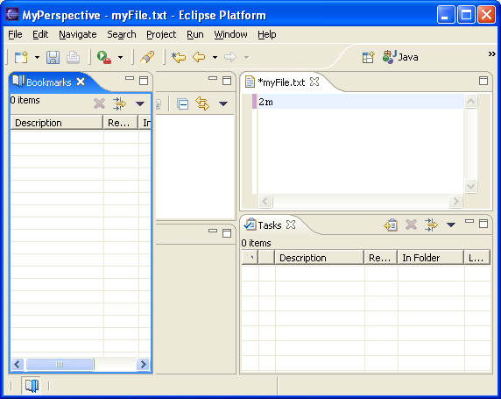
…Fast Views
Click on the Fast View opens the view in the current perspective
Click outside of the view makes it hidden again
Notes:
When you click on the Fast View that is on the shortcut toolbar, it opens in the current perspective. As soon as you click outside of the view, the view becomes hidden again.

Slide 54
Specialized Views
Some of the most commonly used views in Eclipse are:
  Navigator View
  Bookmark View
  Task View
  Search View
These views display specific information

Slide 55
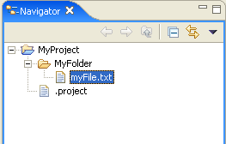
Navigator View
Used for displaying resources in the Workbench
  Provides hierarchical view of the resources
Also used for manipulating resources
  Editing
  Import/Export
  Refactoring
Notes:
Commonly used buttons in the Navigator’s view are Back and Forward buttons.
Back button displays the hierarchy that was displayed immediately prior to the current display.
Forward button displays the hierarchy that was displayed immediately after the current display.

Slide 56
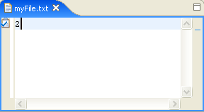
Adding Tasks
Tasks usually indicate action for the resource
  Associated with resources
    With lines in a file
  Generic
To add a task:
  Pop-up the menu on a line in the editor
  Choose Add Task…
To delete task:
  Pop-up the menu on a task
  Choose Remove Task…
Notes:
Generic tasks are created from the Tasks View.

Slide 57
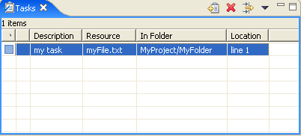
Tasks View
Displays all tasks
  Tasks associated with the resources
  Generic tasks
  Compiler errors that occur during the development
Notes:
Tasks could be manipulated from the Tasks View. You can delete tasks, add generic tasks from the view. Double-click on the task in the Task View opens an editor on the resource the task is associated with.
Double-click on a generic task doesn’t open any editor as generic tasks are not associated with a resource.

Slide 58
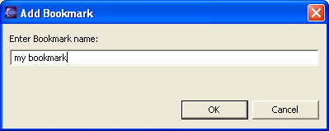
Adding Bookmarks
Bookmarks are used as markers for lines in a file
To add a bookmark:
  Pop-up menu on a line in the Editor
  Choose Add Bookmark…
  Specify bookmark name
  Click OK
Notes:
Unlike tasks that indicate specific action, bookmarks are simply markers in files or on resources, that allow you to quickly relate back to those lines in files.

Slide 59
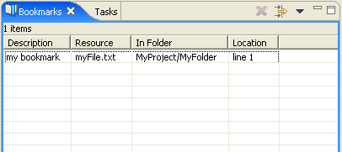
Bookmarks View
Bookmarks View displays all bookmarks available
Allows manipulation of the bookmarks:
  Double-click on a bookmark opens the editor on the resource that bookmark is associated with.
Notes:
In the bookmarks view all available bookmarks are displayed.
To delete a bookmark, select the bookmark (either on line of a file, or entire file, or in Bookmarks View) and click Delete Bookmark from the context menu.

Slide 60
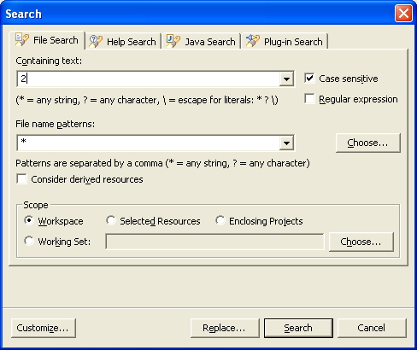
Searching
Eclipse comes with an extensive Search mechanism
  You can search for entities such as files, text, and Java classes
To start search:
  Select Search → Search… from the menu
  Choose search criteria
  Click Search
Notes:
The Search is commonly used in Eclipse and in general, Java development. Using the Eclipse search mechanism you can find Java classes, methods, implementers, references quite easily.

Slide 61
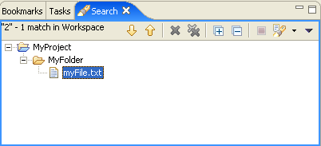
Search Results
Displayed in a Search View
Double-click on an item in a view opens an editor on that item
Search Views allows for sorting and next search

Slide 62
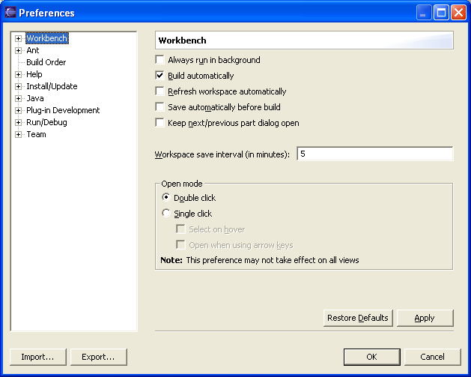
Preferences Dialog
Used for customization in the Eclipse
  For setting user preferences
  Opens by selecting Window → Preferences from the menu
Notes:
In the Preferences dialog you can set many different preferences, such as how Java code is formatted, JREs, Javadoc, and the appearance of the debugger

Slide 63
Module Summary
In this module you have learned:
  What Eclipse does, its background and its components
  How Eclipse is used
  How to download, install and run Eclipse
  How to create and run multiple workspaces with Eclipse
  How to use Eclipse’s Workbench what it contains

Slide 64

Labs!
Lab: Installing and Running Eclipse
Notes:
Now it’s time for the lab.

